Slide 1
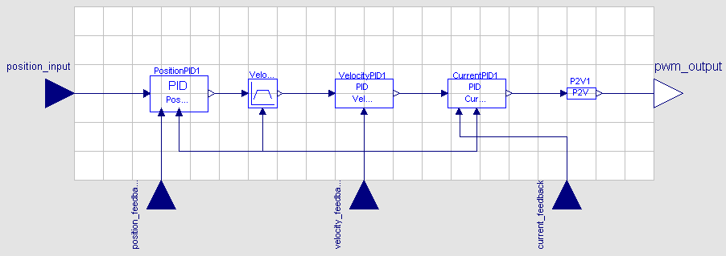
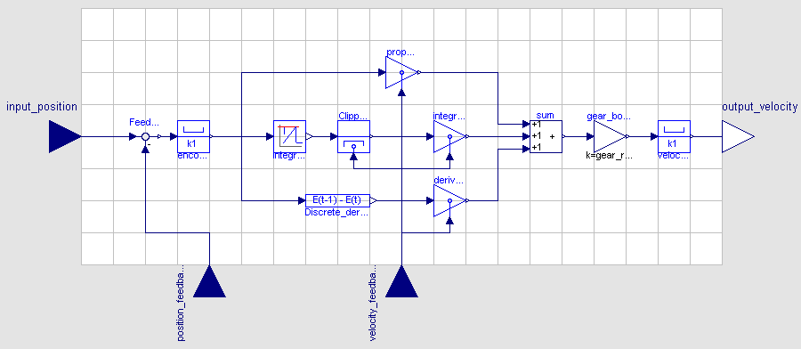

Slide 2
Parameter value (k)
Velocity (v)
0
-threshold
threshold

Slide 3
m1,c1
y
m2,c2
Best line
Vertical offset
m3,c3
Data set
x

Slide 4
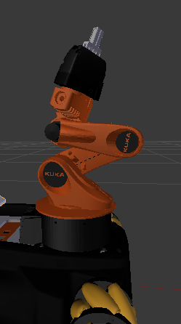
Two-finger gripper
Gripper body
Link 5
Joint 5
Link 4
Joint 4
Link 3
Joint 3
Link 2
Joint 2
Link 1
Joint 1
Link 0
Fixed base

Slide 5
Controller
Position PID or
Velocity Ramp
Generator
Set
Position
Velocity
Controller
Current
Controller
SVPWM
Motor
Position
Feedback
Velocity
Feedback
Current
Feedback

Slide 6
Controller
Position PID or
velocity ramp
generator
Set
position
Velocity
controller
Current
controller
SVPWM
Motor
Position
feedback
Velocity
feedback
Current
feedback

Slide 7
Position PID
Proportional gain
Integral gain
Feedback
+
Sum
Set velocity
(velocity PID
input)
Set
position
+
+
Limiter
Limiter
Integral
-
+
Derivative gain
Derivative
Position
feedback
Velocity
feedback

Slide 8
Velocity PID
Proportional gain
Set velocity
(position PID
output)
Feedback
Integral gain
Set current
(current PID
input)
+
Sum
+
Integral
+
Limiter
-
+
Derivative gain
Derivative
Velocity
feedback

Slide 9
Current PID
Proportional gain
Set current
(velocity PID
output)
Feedback
Integral gain
Set PWM
+
Sum
+
Integral
+
Limiter
-
+
Derivative gain
Derivative
Current
feedback

Slide 10
Velocity PID
Proportional gain
Set velocity
(position PID
output)
Feedback
Integral gain
+
Sum
Set current
(current PID
input)
+
Integral
+
Limiter
-
+
Derivative gain
Derivative
Velocity
feedback

Slide 11
Current PID
Proportional gain
Set current
(velocity PID
output)
Feedback
Integral gain
Sum
Set PWM
+
+
Limiter
(set PWM)
Integral
+
-
+
Derivative gain
Derivative
Current
feedback

Slide 12
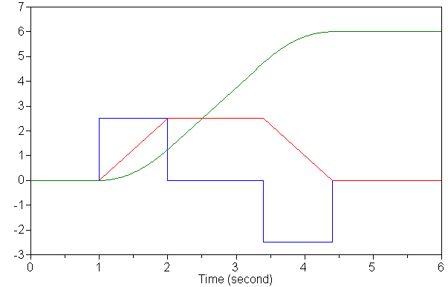
Acceleration (m·s⁻²)
Velocity (m·s⁻¹)
Position (m)

Slide 14
Velocity
Slow down point
Maximum velocity
Motion A
Motion B
Time

Slide 15
Target position reached state
Velocity
Maximum
velocity
Velocity
tolerance
Position
Slow down point
Position
tolerance
Set
position

Slide 16
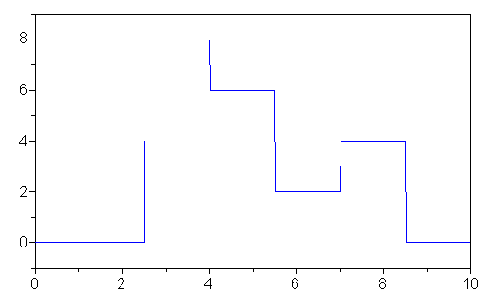
Set Velocity (rad/s)
Time (s)

Slide 17
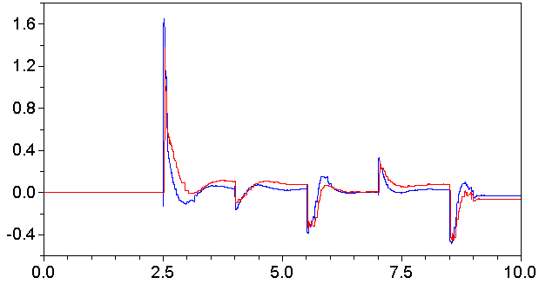
Model Set Current (A)
Measured Set Current (A)
Time (s)

Slide 18
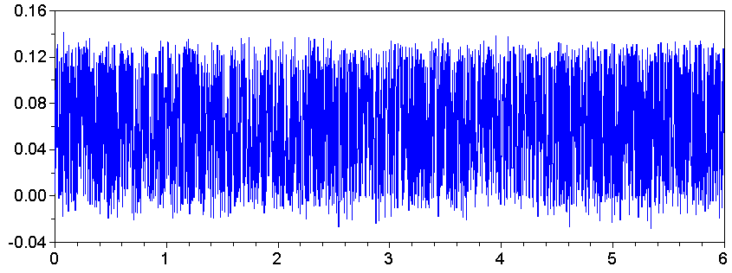
Measured torque (Nm)
Time (s)

Slide 19
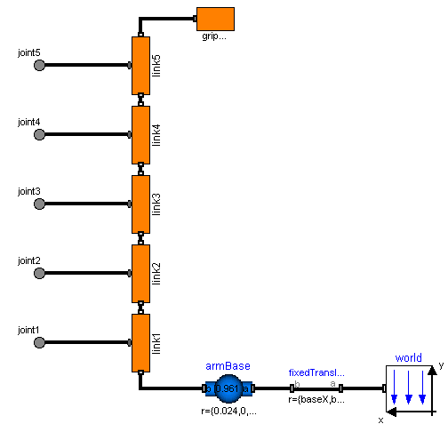
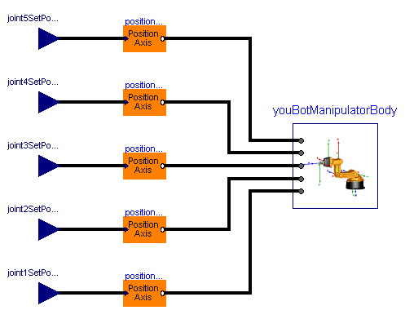
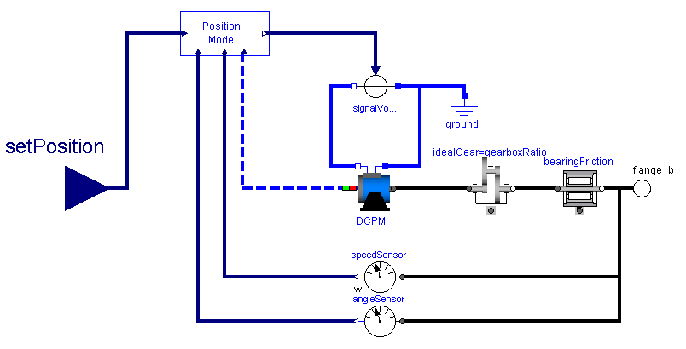

Slide 20
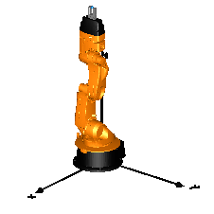
+90°
Joint 5 motion

Slide 21
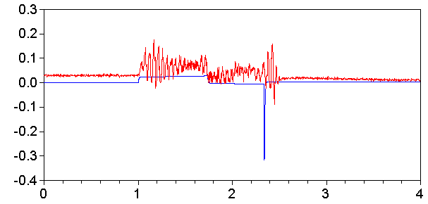
Model
Measured
Ampere
Time (second)

Slide 22
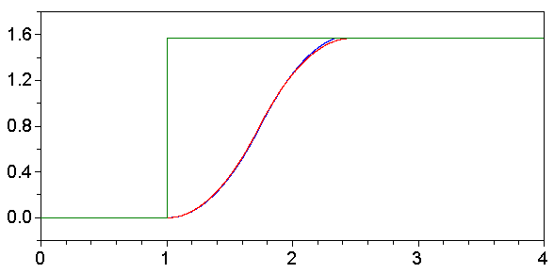
Model
Measured
Set Angle
radian
Time (second)

Slide 23
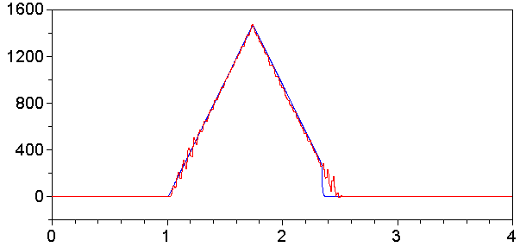
Model
Measured
RPM
Time (second)

Slide 24
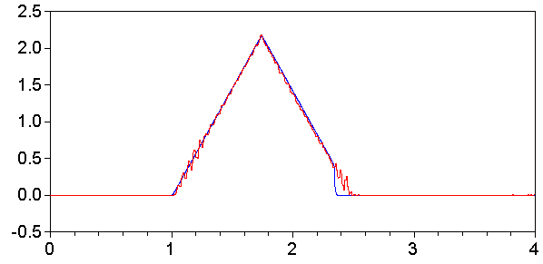
Model
Measured
radian/second
Time (second)

Slide 25
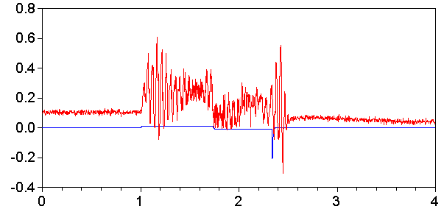
Model
Measured
Nm
Time (second)

Slide 26
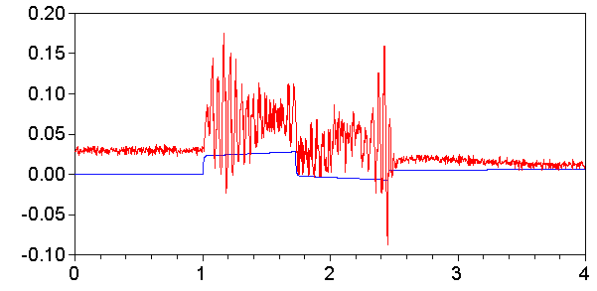
Model
Measured
Ampere
Time (second)

Slide 27
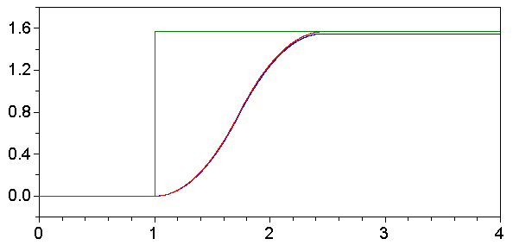
Model
Measured
Set Angle
radian
Time (second)

Slide 28
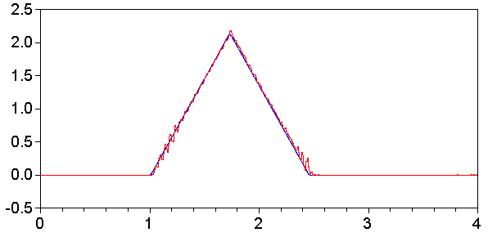
Model
Measured
Radian/second
Time (second)

Slide 29
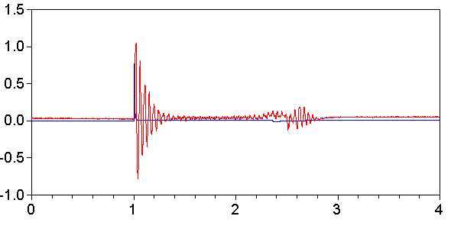
Model
Measured
Ampere
Time (second)

Slide 30
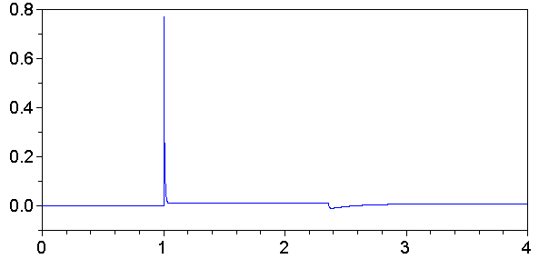
Model
Ampere
Time (second)

Slide 31
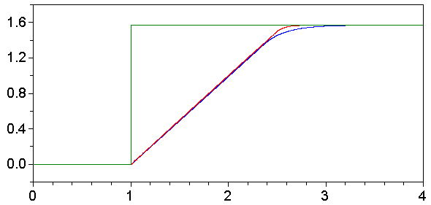
Model
Measured
Set Angle
Radian
Time (second)

Slide 32
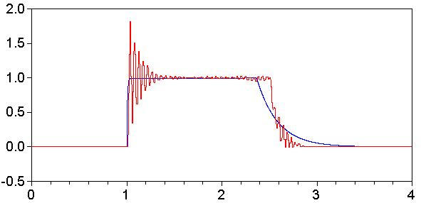
Model
Measured
Radian/second
Time (second)

Slide 33
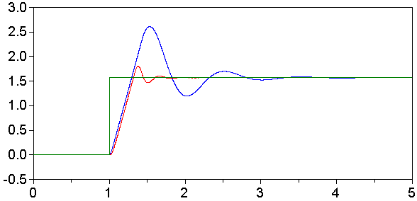
Model
Measured
Set Angle
Radian
Time (second)

Slide 34
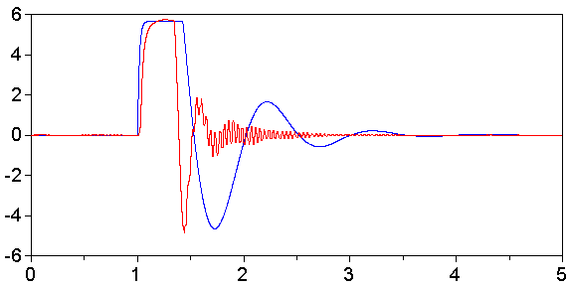
Model
Measured
Radian/second
Time (second)

Slide 35
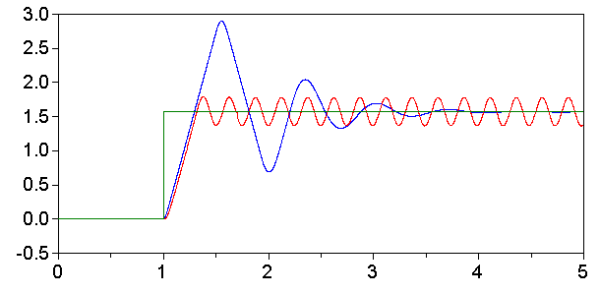
Model
Measured
Set Angle
Radian
Time (second)

Slide 36
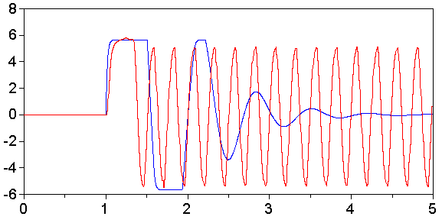
Model
Measured
Radian/second
Time (second)

Slide 37
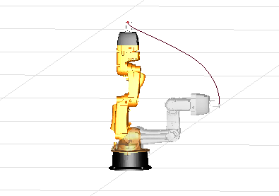

Slide 38
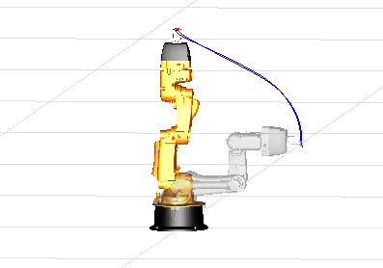
Model
Measured

Slide 39
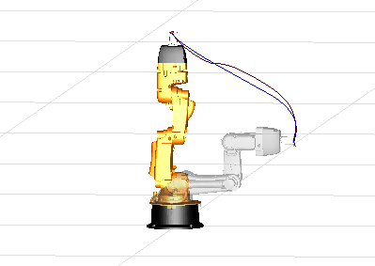
Model
Measured

Slide 40
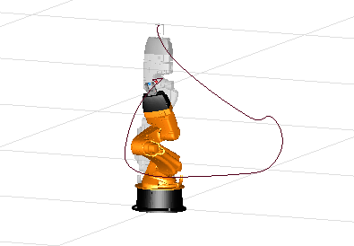
Model
Measured

Slide 41
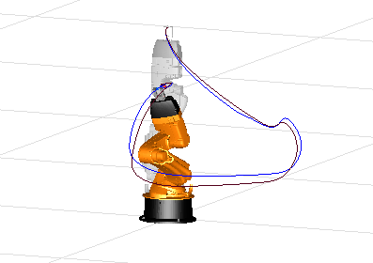
Model
Measured

Slide 42

Model
Measured

Slide 43
Friction
Friction
Fc + Fv
Fc
Velocity
Velocity

